Slide 1

Al ToolBox
Welcome to Al ToolBox
Your comprehensive platform for free Al-powered tools. Create, edit, and enhance content with cutting-edge.

Slide 2

What is Al ToolBox ?
A responsive website that serves as a central hub for discovering and using multiple Al-powered tools for writing, images, notes, speech, games, and chatbots-all free, no registration required.

Slide 3
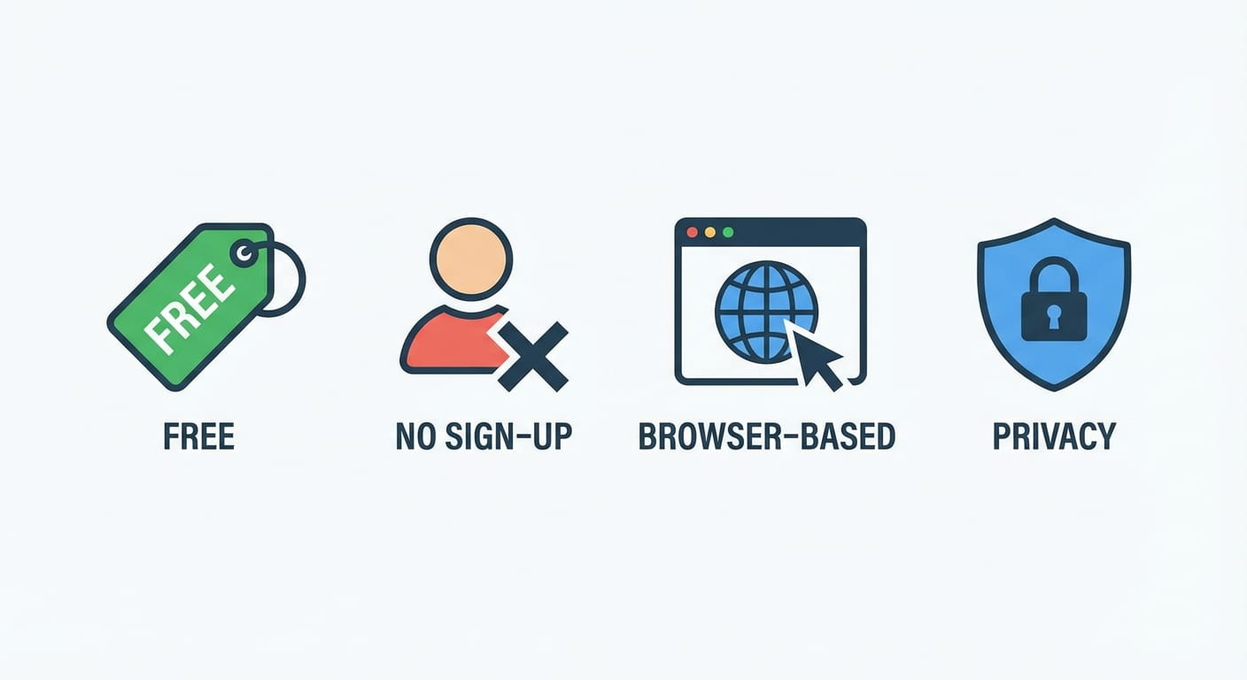
Objectives
Create a comprehensive database of Al tools organized by category.
Help students understand each tool's purpose and usage.
Promote ethical and productive use of Al.

Slide 4
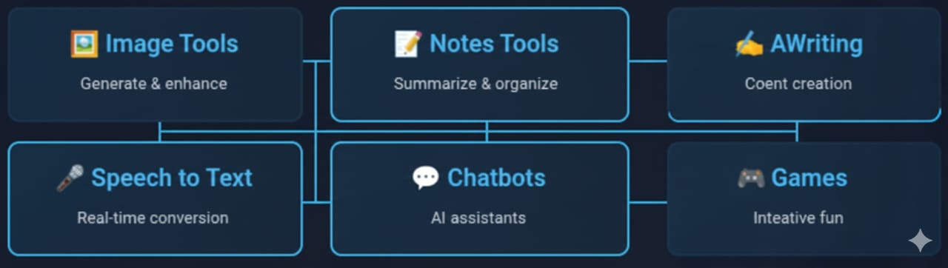
Available Tools

Slide 5


